Slide 1


Team hyperlearn
REAL TIME AIR QUALITY MONITORING AND WEATHER FORECASTING SYSTEM
Theme-cognitive artificial intelligence
Made By:-
Shayoun bhaduri
Pranjal Srivastava
Ayush misra

Slide 2
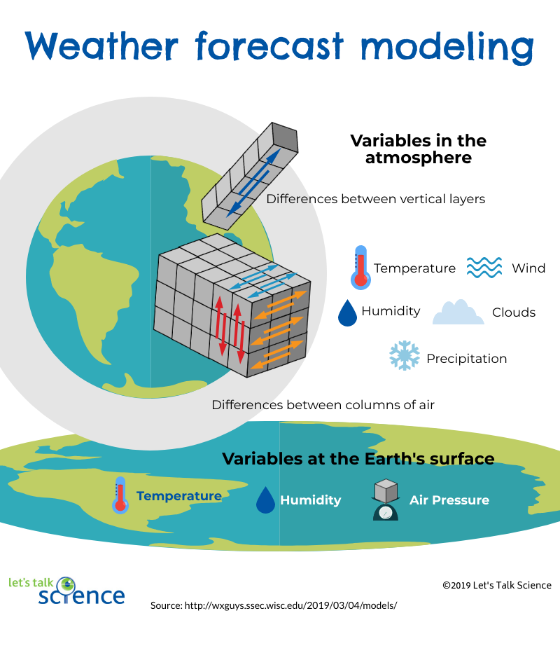
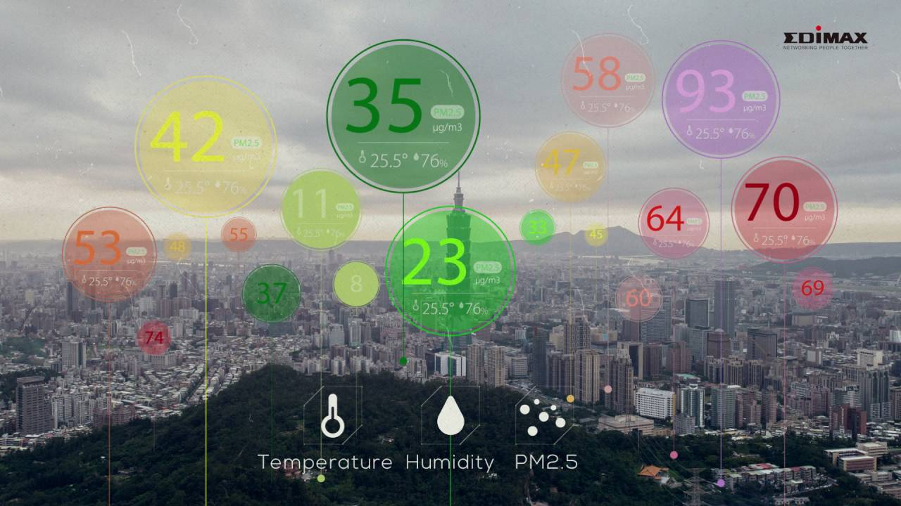
problem statement
Our Problem System can be divided into two parts:-
REAL TIME AIR QUALITY MONITORING SYSTEM
WEATHER FORECASTING SYSTEM

Slide 3
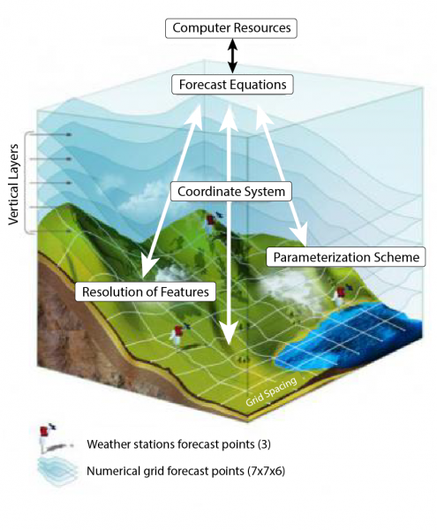
WEATHER FORECASTING SYSTEM
Weather forecasting system is a computer program that provides meteorological information for future times at given locations.
In modern forecasting models, Numerical Weather Prediction is mostly applied and this means, “a set of simplified equations used to calculate changes in atmospheric conditions”

Slide 4
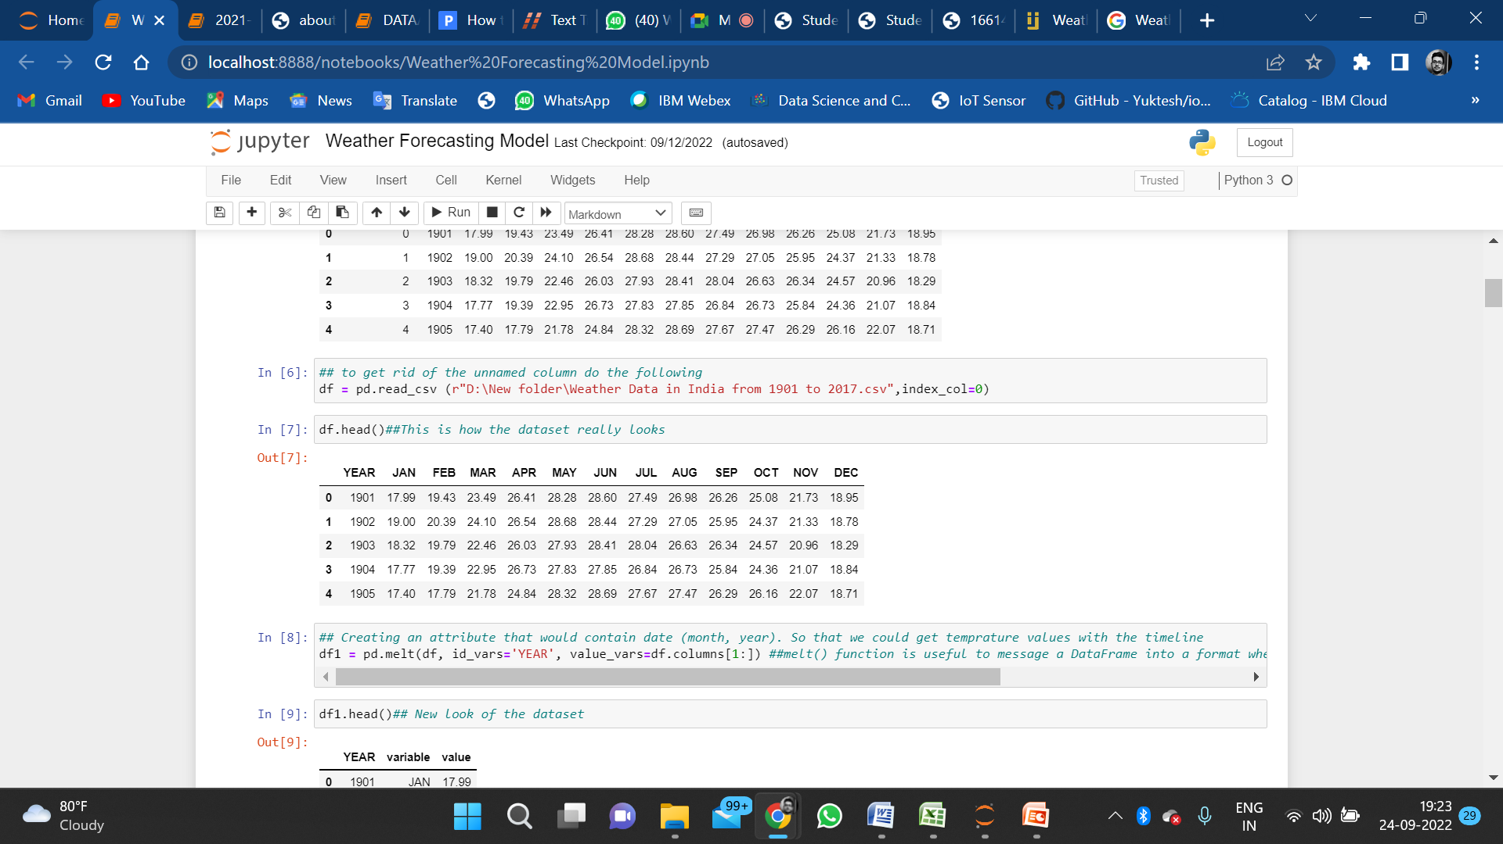
Our weather forecasting model is based on Decision tree model of Machine Learning which uses previous data to predict the forecast of the next year.
This is the picture of First Five Columns of the Dataset that we have taken as Reference.
The Dataset taken consists of Weather temperatures from the year 1901 to 2017

Slide 5
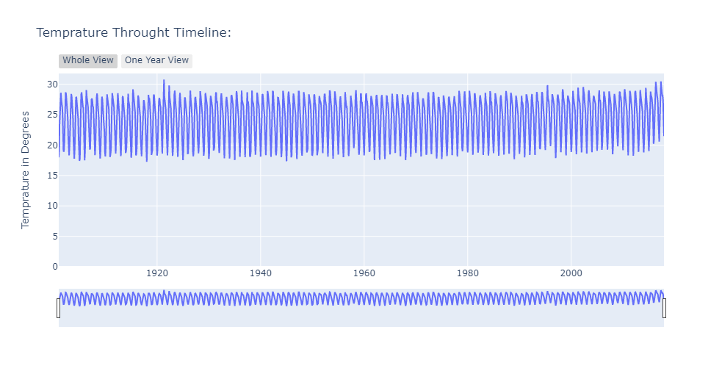
We Start by plotting a temperature scatter plot graph throughout the given timeline of 1901 to 2017 .

Slide 6
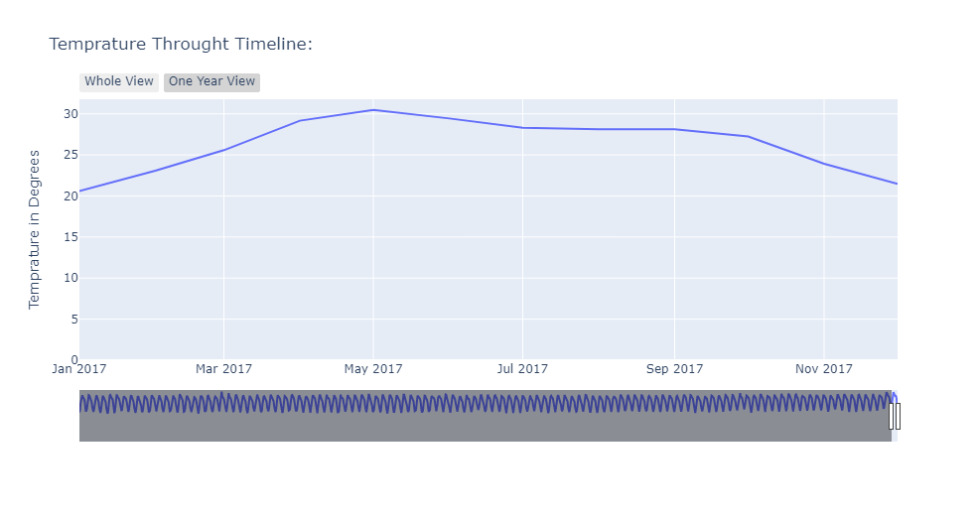
Temperature of a particular year 2017

Slide 7
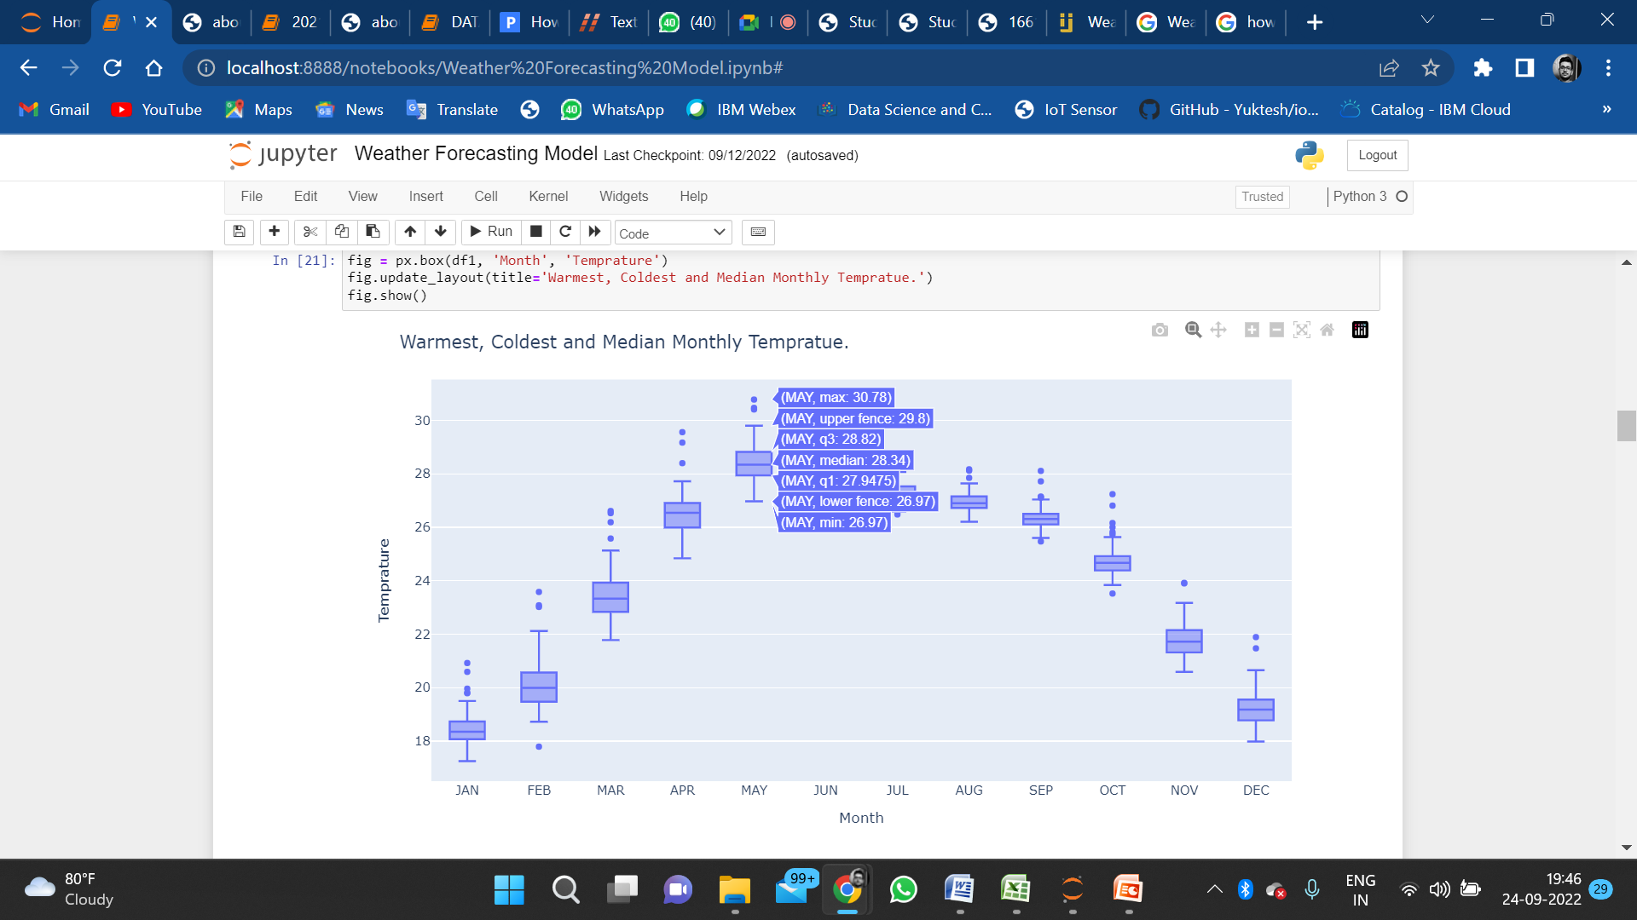
Next we have made a box plot to show the median temperature of each month.
In the figure it can be seen that May has recorded the Maximum Temperature of 30.78 ; Median Temperature of 28.34 and a Minimum Temperature of 26.97
This graph plots the- Maximum Temperature Median Temperature Median Temperature ,
for all the 12 months of a year
Box Plot to show the Median , Maximum and Minimum Temperatures for the Dataset

Slide 8
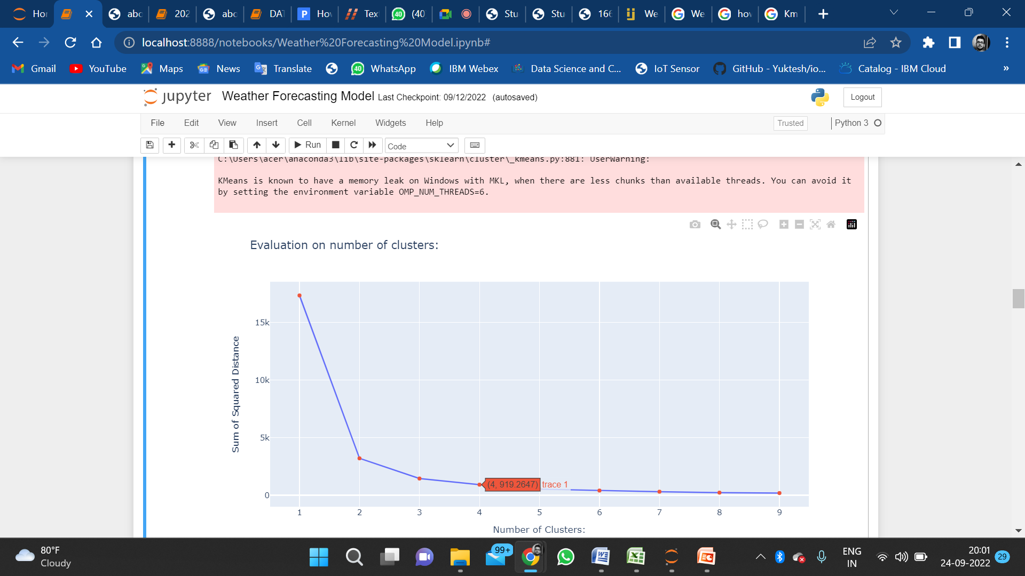
After finding the Median, Max and Minimum Temperature, we now use the Kmeans Cluster Method to find out the temperature for a range of Kilometers. Kmeans Cluster has been used to identify the temperatures in a range of Kilometers.
This graph is a Line Graph showing the number of clusters per Square Kilometer distance.
We can see that 4 clusters are formed at 919.2647 squared kilometer distance.
This helps to find out a mean temperature that can be plotted on the graph.

Slide 9
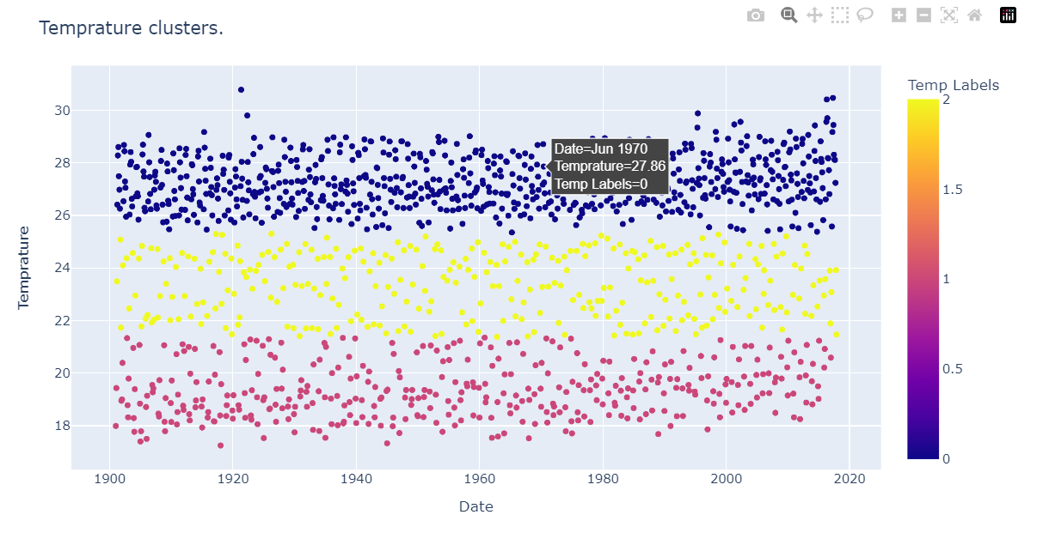
Using K-means Clustering, we have tried to categorically divide the temperatures into the following 3-zones:-
Hot:- This region consist of the hottest or the highest temperatures recorded. It is shown in graph with blue dots.Graph shows the temperature of June 1970
Mild :- This region is marked in the graph with yellow dots and consist of moderate temperatures.
Cold:- This region is shown with red dots and consist of the coldest temperatures.

Slide 10
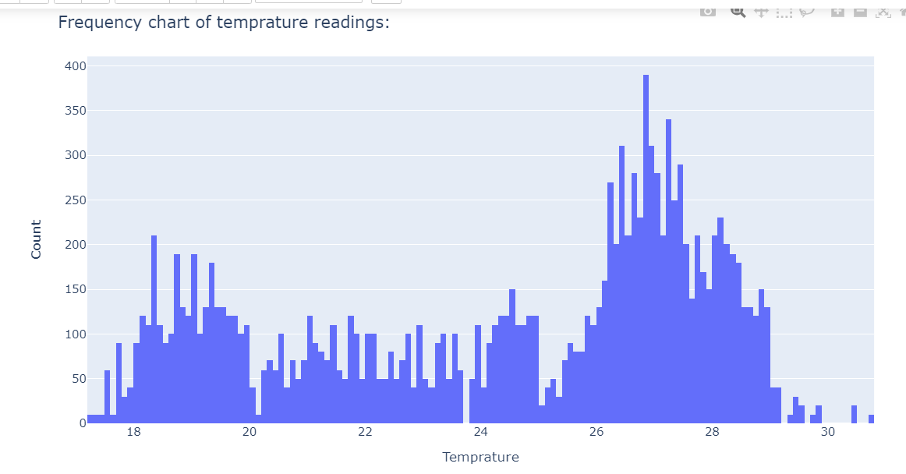
In this graph , we have tried to demonstrate the count of all the average temperatures across the entire dataset.
This graph shows the count of the temperatures given in the dataset.

Slide 11
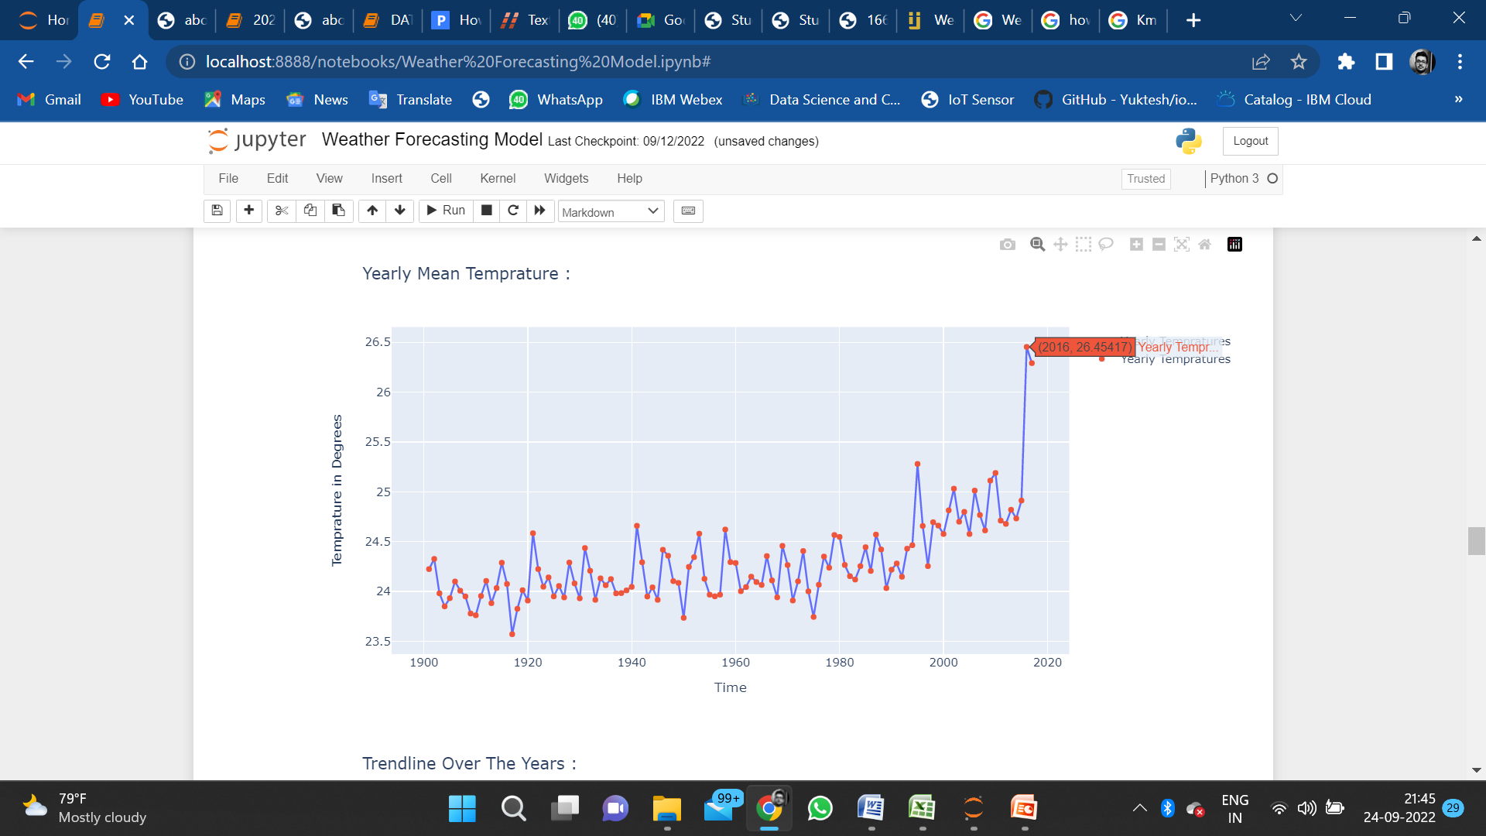
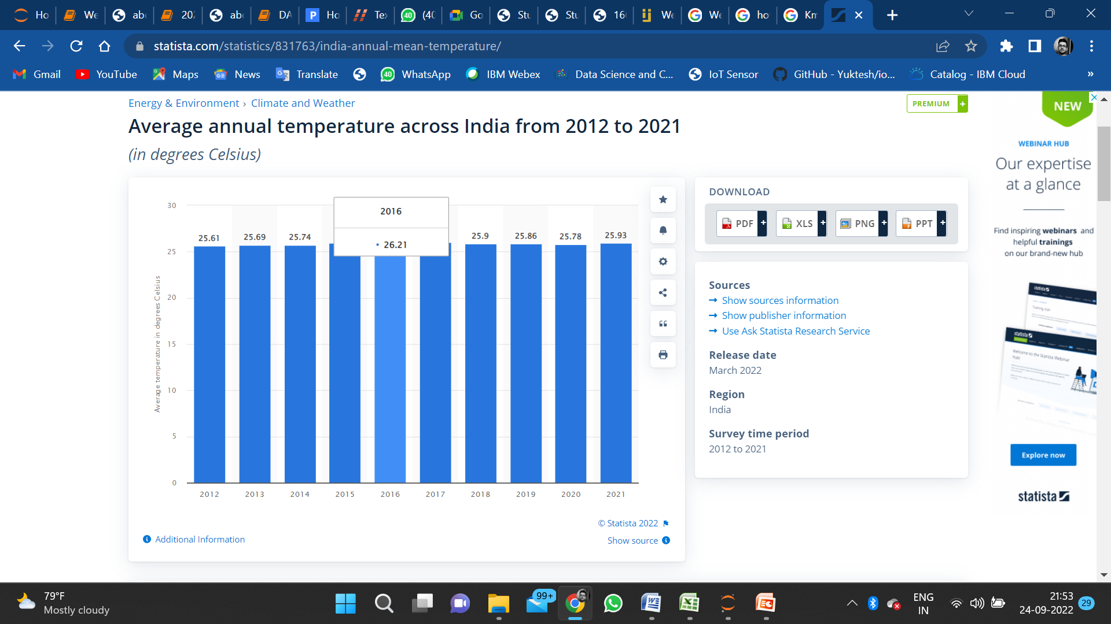
This scatter graph shows the Mean Temperature for the entire Year.
According to statitica.com , the average annual temperature for 2016 recorded is 26.21 and our graph shows average annual temperature recorded is 26.45 ; difference of only .24 degrees celsius only. Thus ,giving the proof of the accuracy of our system.

Slide 12
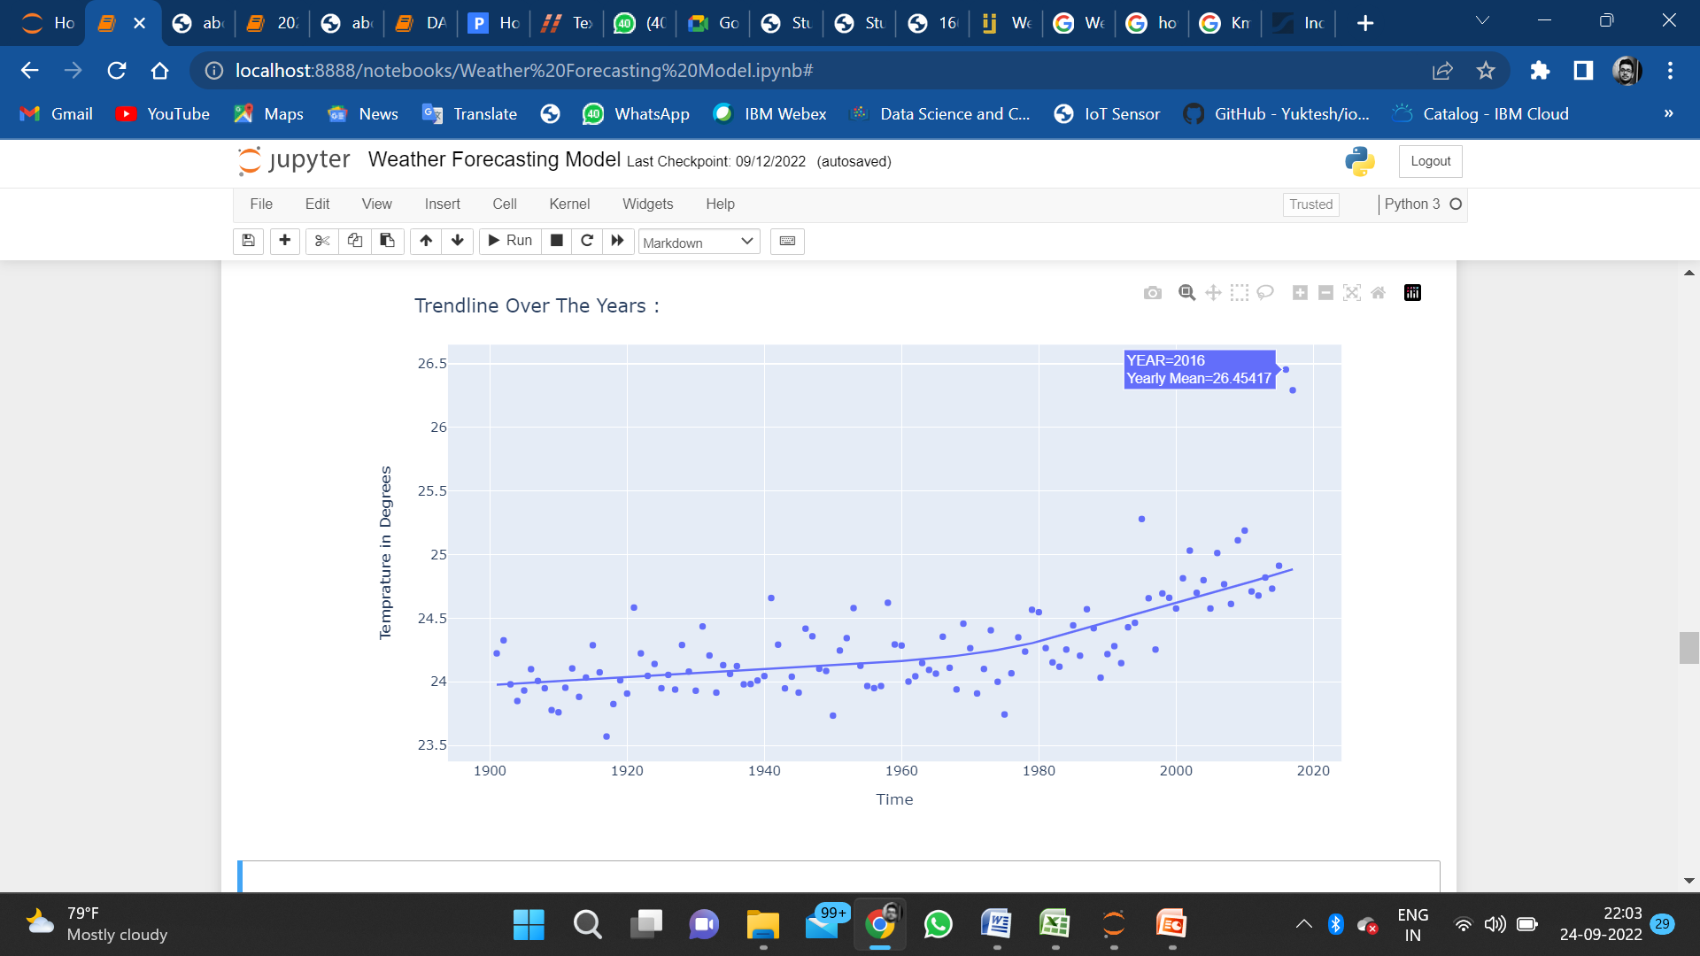
This graph shows the trend of temperature that is being followed for the entire decade from 1900 to 2020.
The graph plots the mean temperature for each year using scatter plot and the trend used is lowless.

Slide 13
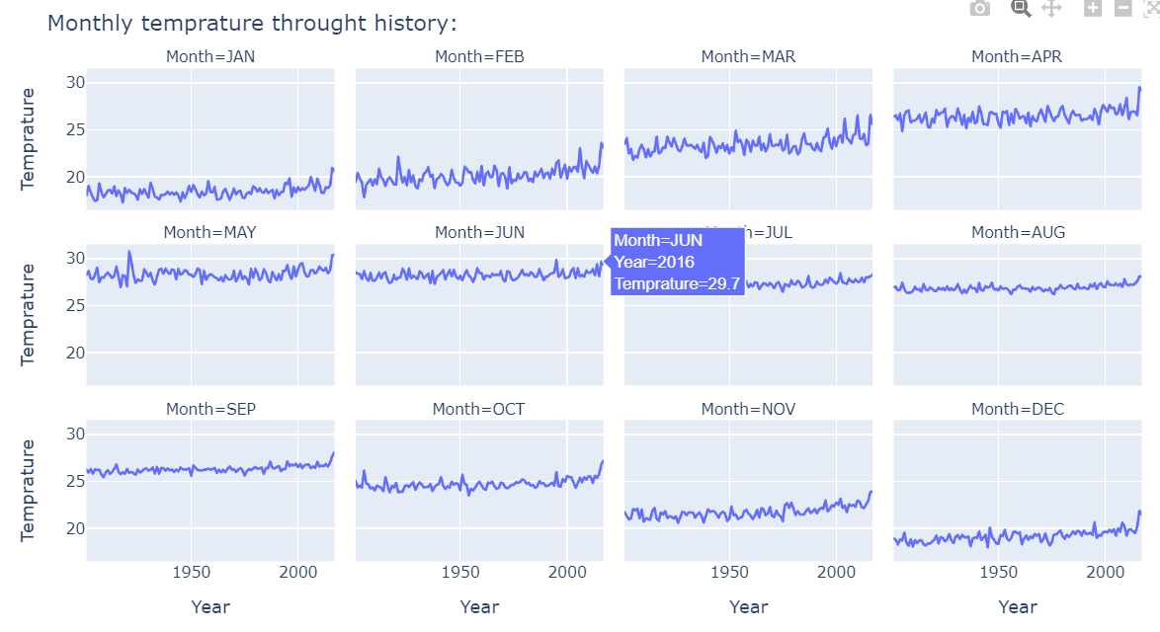
Now, for more accuracy, we try to study the seasonal analysis , by plotting the monthly temperature throughout the history.
The graph shows the monthly mean temperature for each year starting from 1900 to 2017.
This graph shows monthly mean temperature for all the 12 months of the year .
The graph shows the June mean temperature for the year 2016, which records to 29.7.

Slide 14
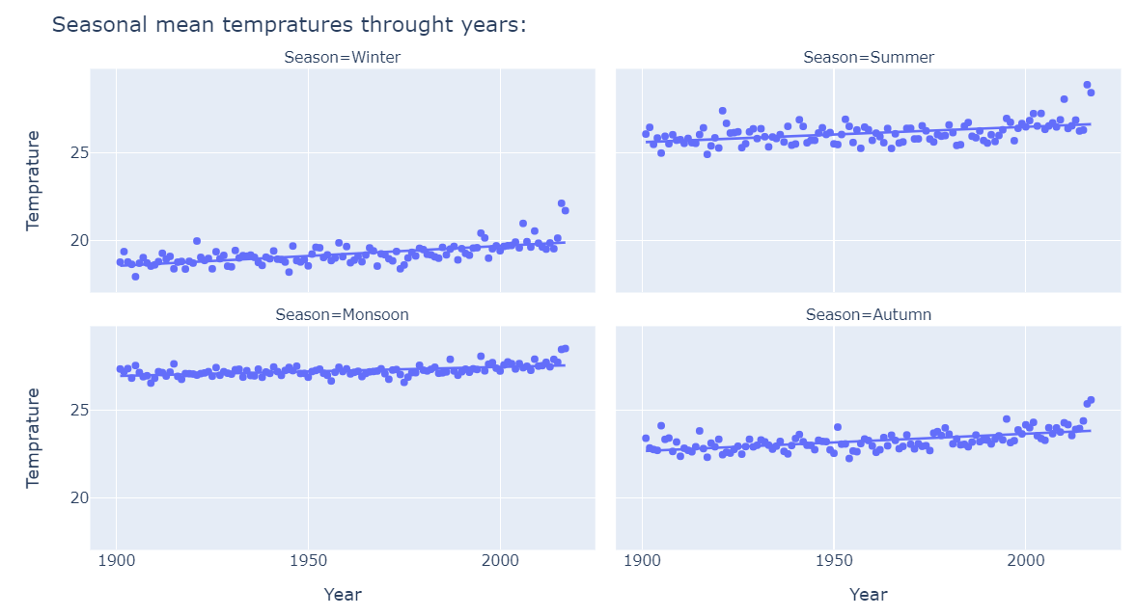
After plotting the monthly mean temperature , we now plot seasonal mean temperature throughout the years.
The graph is again a scatter plot and the trend followed is low less.
The graph shows the trend that is spread across all the four seasons

Slide 15
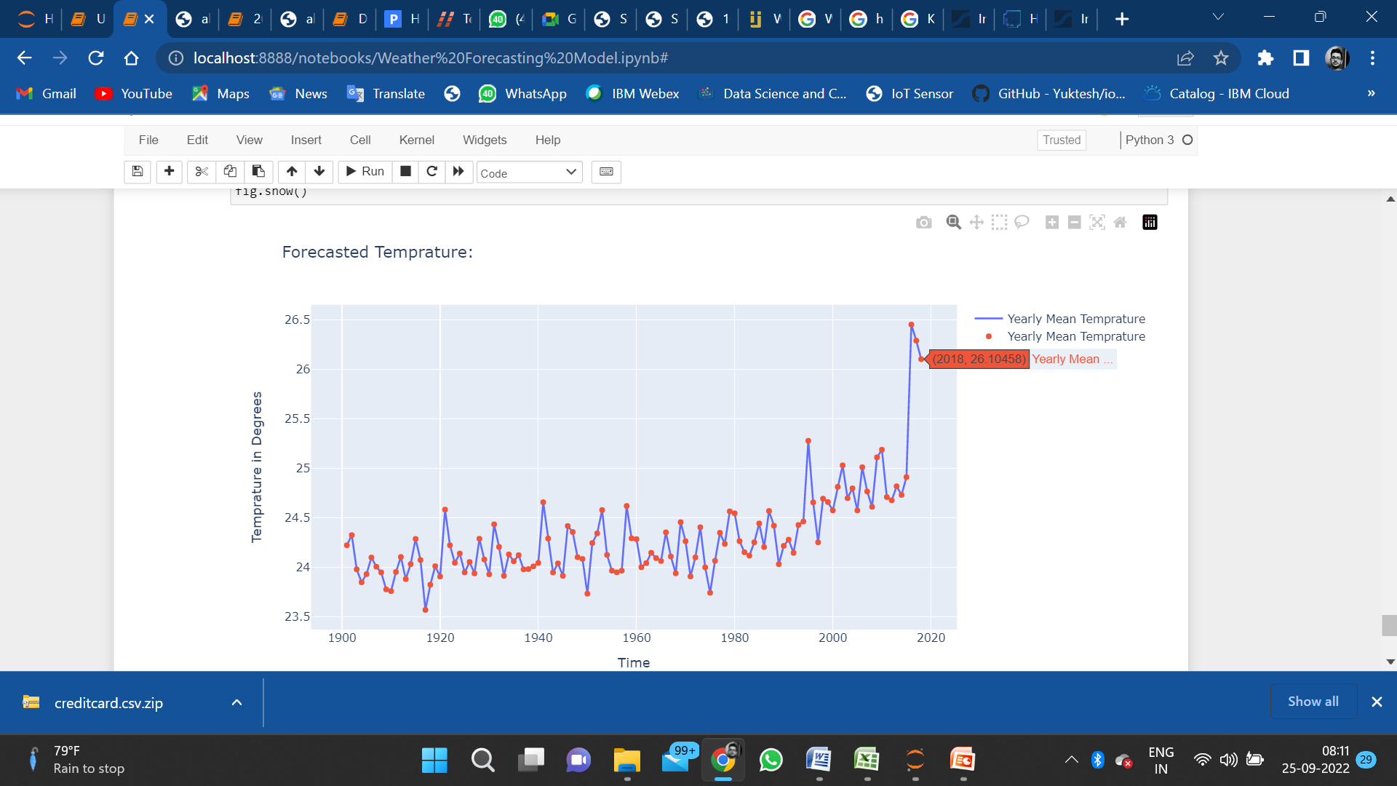
After analysing all the various seasons, we now move on to the most interesting part of the model.
We now forecast the weather for the year 2018.
The graph records a temperature of 26.10 for the year 2018 and according to statistica.com ,the temperature recorded for the year 2018 was 25.9.
According to statistica.com, the Yearly Mean Temperature recorded for the year 2018 was 25.9 .
Our Model vouches for the accuracy of 96.45 which makes our Model the most efficient weather forecasting model in India .

Slide 16
Future Scope

Slide 17
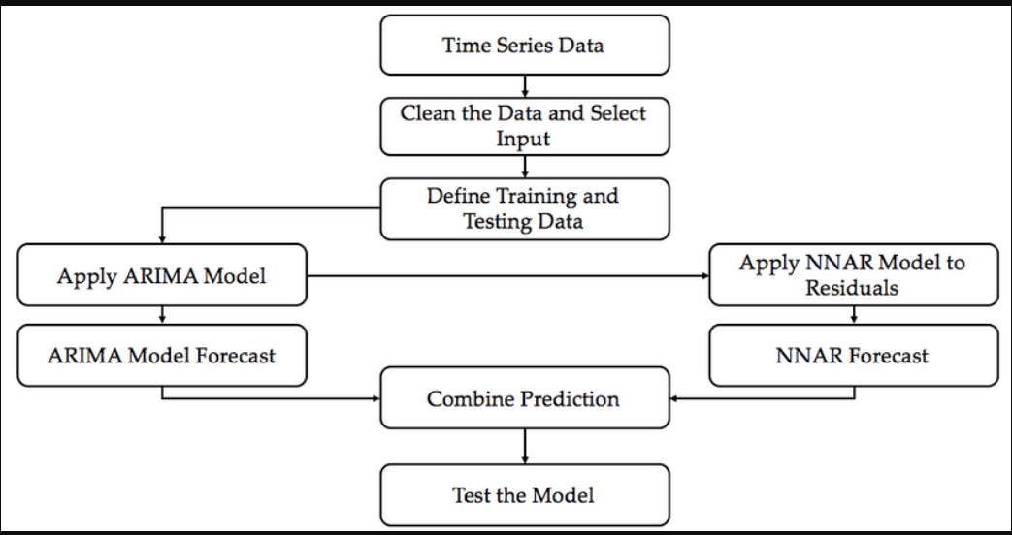
Real time air quality monitoring
Air quality monitoring refers to continuous measurement of specific air pollutants also known as “criteria air pollutants”.
For monitoring the air quality at real time , we will be using the Auto Regressive Integrated Moving Average model (ARIMA) of Statistical analysis.
This flowchart shows how are we going to proceed in the model for Air Quality Monitoring.

Slide 18
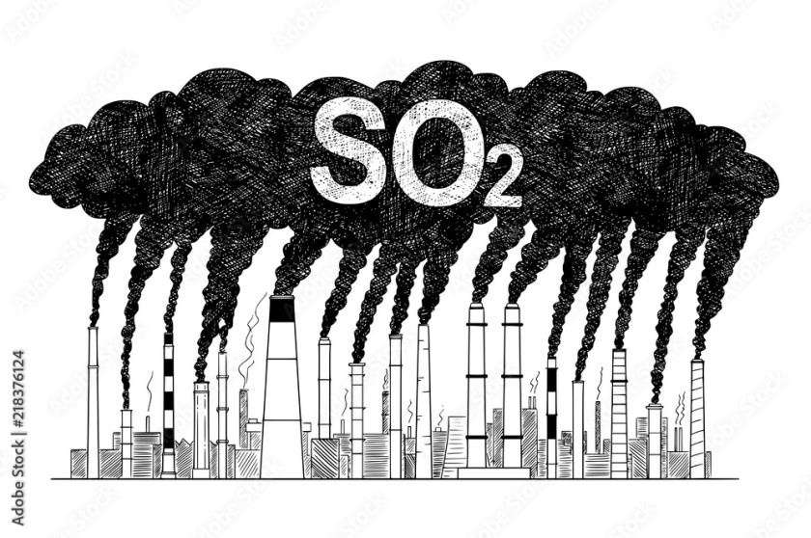
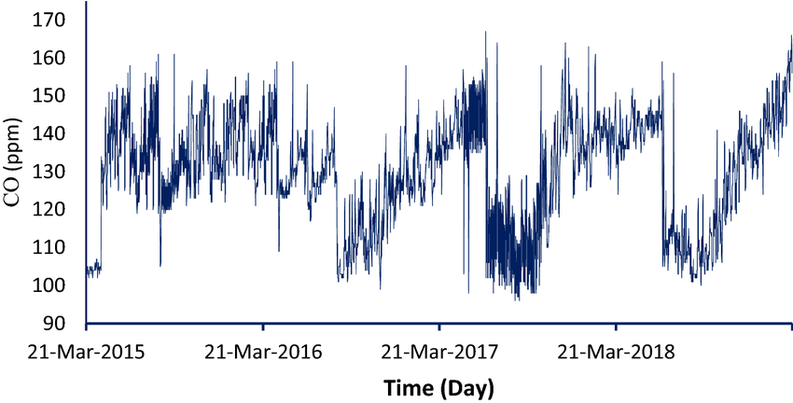
For monitoring the Air Quality, we require data of certain pollutants such as :-
Sulfur-di-oxide(SO₂):-
Sulfur dioxide (SO₂) is a colorless, reactive air pollutant with a strong odor. This gas is a threat to human health, animal health, and plant life.
Carbon monoxide (CO):-
CO is a colorless, odorless gas that can be harmful when inhaled in large amounts. CO is released when something is burned.
Breathing air with a high concentration of CO reduces the amount of oxygen that can be transported in the blood stream to critical organs like the heart and brain.
At very high levels, which are possible indoors or in other enclosed environments, CO can cause dizziness, confusion, unconsciousness and death.

Slide 19
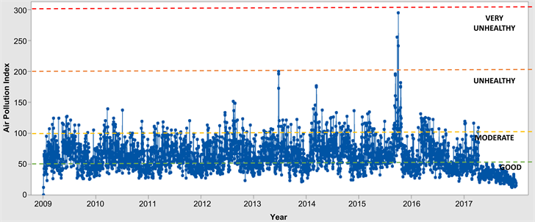
After gathering the information and data, we now try to analyse the air quality for the previous years by plotting line graphs for the data set.
The graph shows the Air Pollution Index for the years from 2009 to 2017.
From the graph it is seen that the year 2016 has the highest air pollution index.

Slide 20
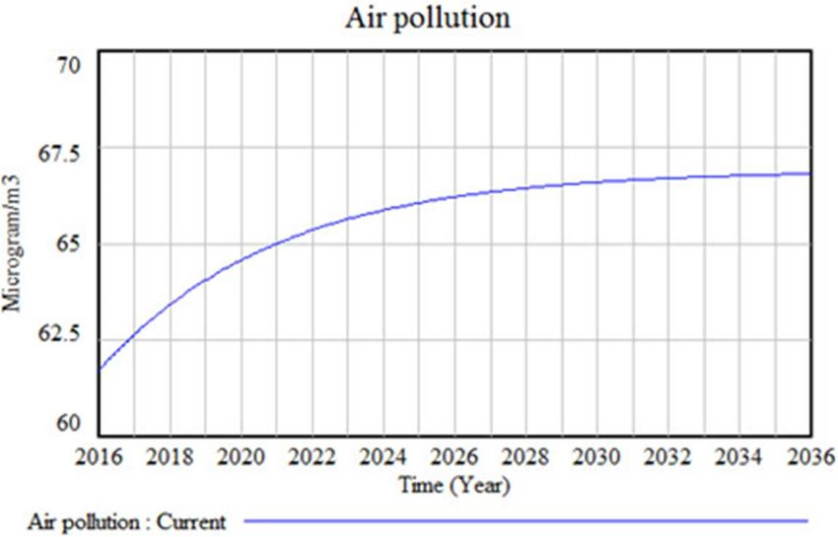
After analysing form the previous line graph we can find out the air pollution index of the next year with the help of ARIMA.
This graph shows the rising trend of air pollution up till year 2036.

Slide 21
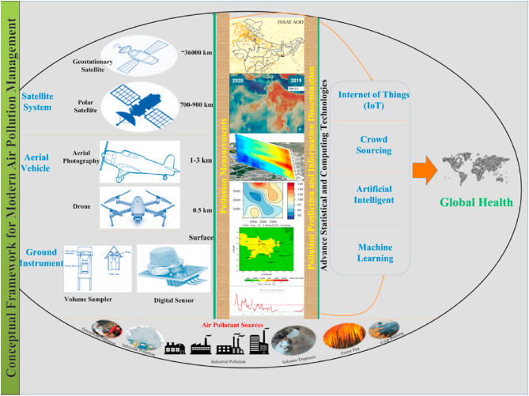
Conclusion
From the beginning we have divided our Problem Statement into two sections:-
First is Weather Forecasting Model:- This model not only predicts the forecasted weather for the future years but also provides us with seasonal analysis as well as monthly analysis , which helps us to understand the trend by which the temperature rises.
Second is Air Quality Monitoring System:- This system helps us to identify the rising trend in the pollutants with the help of the ARIMA Model . The analysis that this model provides helps to keep a check on the rising trend of the pollutant level in the air , thereby keeping a check on Global Warming and Environment Pollution.

Slide 22
THANK YOU

